Slide 1
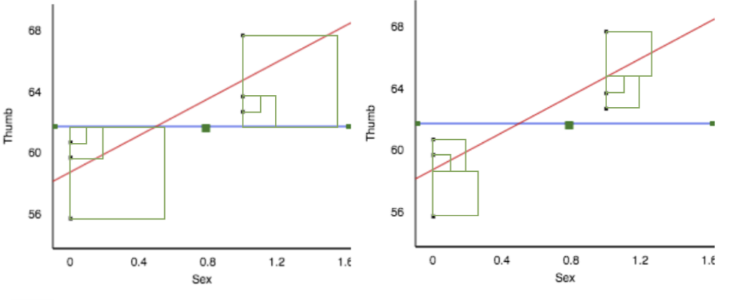
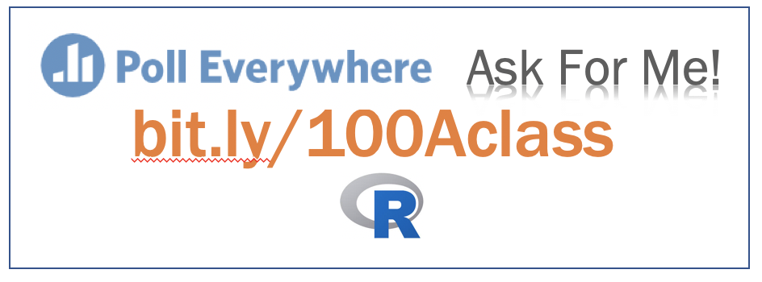
Getting started…
Rows A through J only; sit with a group of 3-5
Discuss: which diagram shows error from the empty model; which the two-group model?

Slide 2
Adding an Explanatory Variable to the Model (Continued)
Psych 100A Spring 2019
Prof. Jim Stigler

Slide 3
Today
Continue discussion of the two-group model
Partitioning scores
Partitioning sums of squares
PRE
Three-group model
Or, we can just answer your questions.

Slide 4
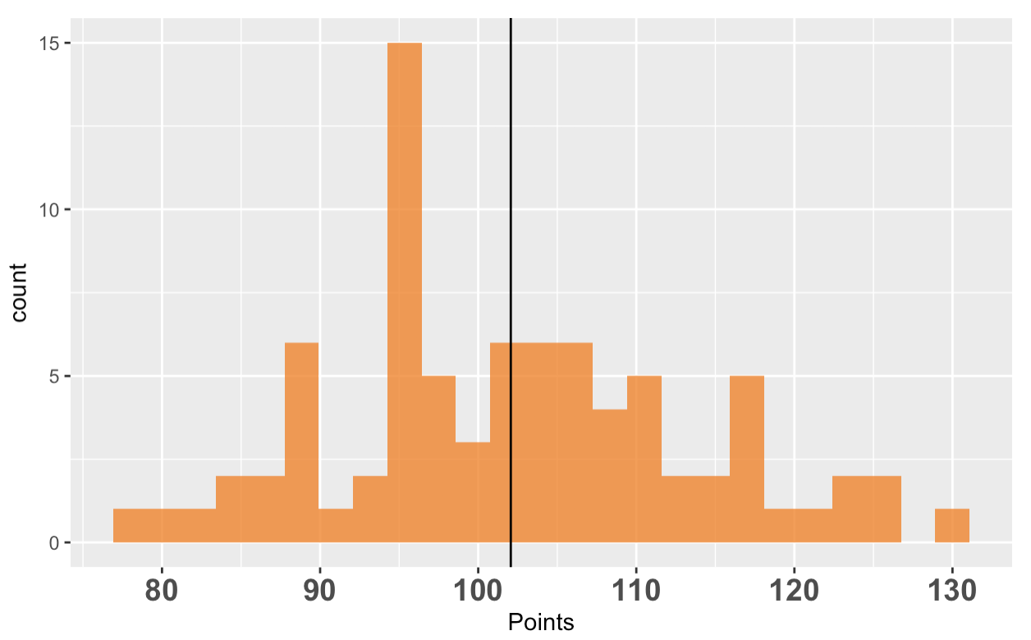
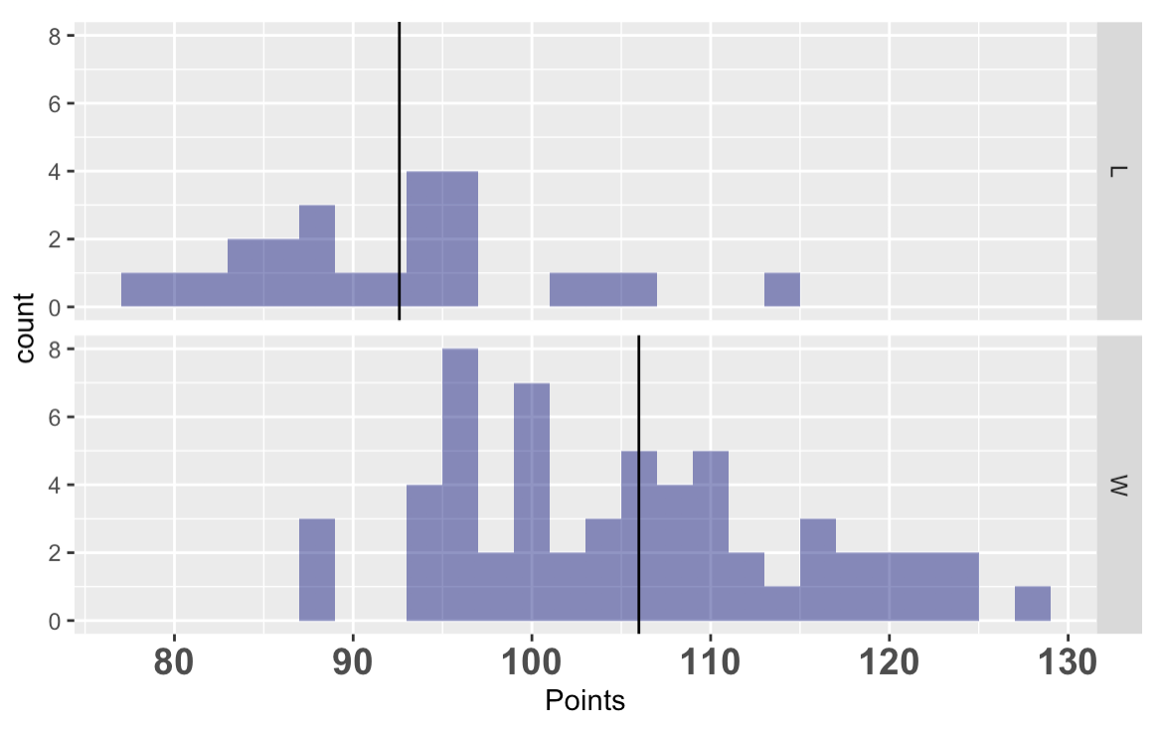
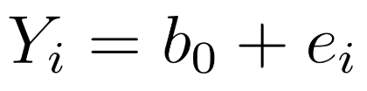
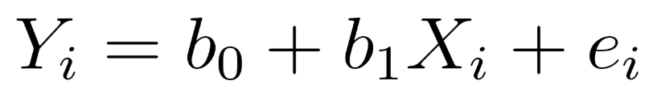
Explanatory Models Seek to Reduce Error – Partition Variation into Explained and Unexplained (Error)
empty
two-group
DATA = MODEL + ERROR
Notes:
Get the students to gesture.

Slide 5

Sum of Squares: Critical!
DATA = MODEL + ERROR
Explained
Variation
Unexplained
Variation
SS Model
SS Error
Group
Model
SS Total
Empty
Model
Total
Variation in Outcome
What is SS?
Total Variation = Explained Variation + Unexplained Variation

Slide 6
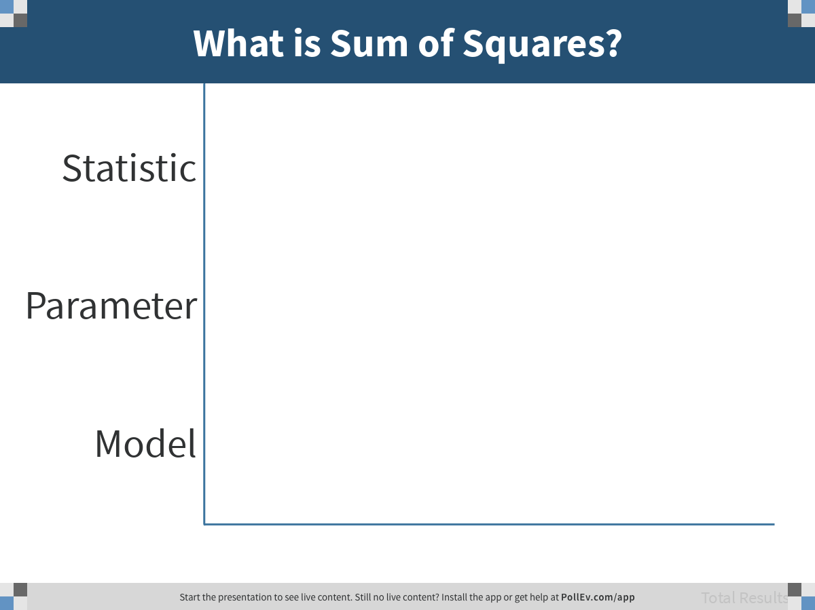
Notes:
What is Sum of Squares?
https://www.polleverywhere.com/multiple_choice_polls/Td7gKrxSlTt5I9cr5EfCM

Slide 7
Vegemite.brief (continued)

Slide 8
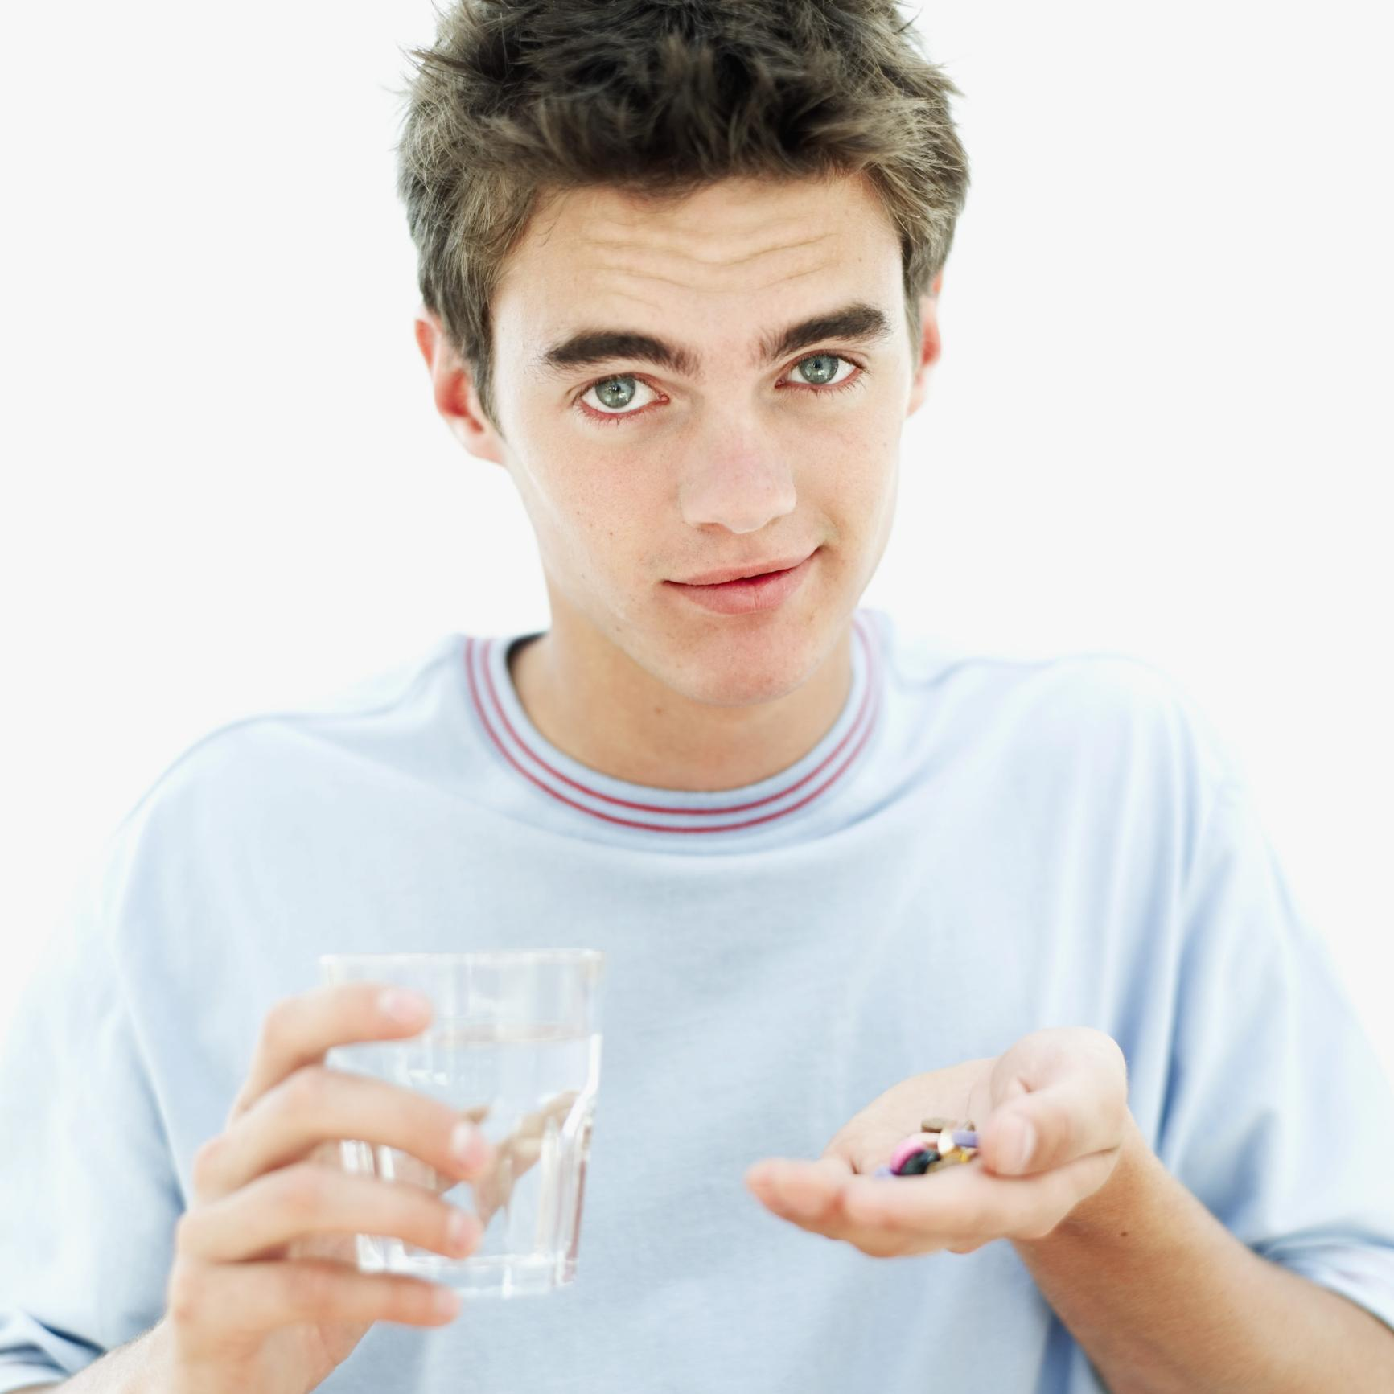
Can Respect Improve Medical Adherence?
Hypothesis: Respectful instructions will create better medical adherence
(especially in adolescents)
David S. Yeager, Quinn Hirschi, and Robert A. Josephs

Slide 9
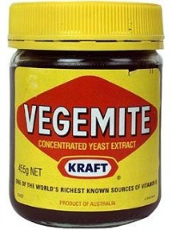
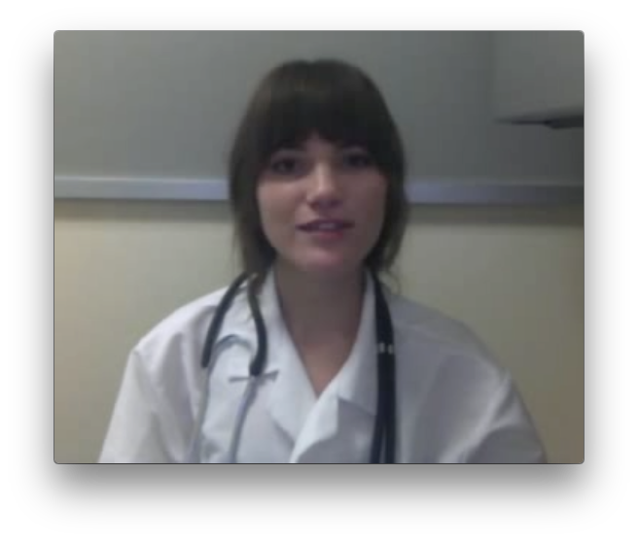
Study Procedure
0.1 g
0.4 g
Taste medicine
(spoon1)
Watch video instructions
(Respectful or Not)
How much medicine did they eat? (spoon2)
Notes:
**
As soon as participants arrived in our lab, we had them sample 0.1 gram of the Vegemite.
We wanted them to see how it tasted before beginning our experiment, and as you might have predicted, they rated it as overwhelmingly bitter and unpleasant to take.
Then, we told participants they would be participating in two separate studies that had been bundled together for the sake of time.
**
In the first study, the researchers would be measuring the effects of testosterone administration on individual attitudes and preferences.
Under the guise of this study,
We collected a baseline salivary hormone sample.
Then we had participants self administer a nasal spray that contained 14 milligrams of either testosterone or a placebo control (participants and experimenters were both blind to drug condition, and were kept blind to drug condition throughout the experiment).
As we started waiting for the drug to absorb in their system, we had participants complete a few questionnaires.
**
After participants completed the questionnaires, we told them they would be beginning the second study. In this study, they believed we were helping the medical school develop a new protocol to evaluate medical students.
First, participants read medical magazines to “familiarize themselves with the medical field.” In reality, they were completing an innocuous tasks while we waited exactly 45 minutes for the drug to absorb in their system.
At exactly 45 minutes, participants were randomly assigned (via a Qualtrics survey) to receive status-enhancing or status-diminishing video instructions from a medical student to take another spoonful of .4 gram of the Vegemite, which was on the table in front of them.
Immediately after receiving these instructions, participants made a real choice about whether or not to take the spoonful of Vegemite, and then they reported how respected, autonomous, competent, and high status the medical student giving them the instructions made them feel.
We assessed these feelings with 8 items – 2 items for each construct. For example, one of the items to measure respect was “The person in the video made me feel respected.”

Slide 10
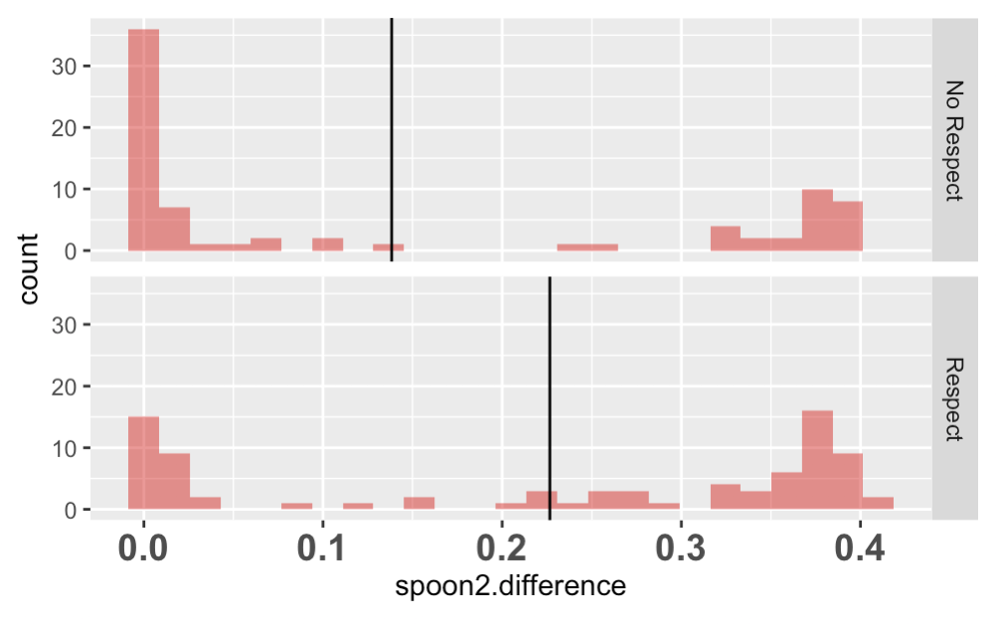
spoon2.difference by Respect
We ended here on Monday…
Respect, or random?
What are the possible causes of this mean difference?
Notes:
Make sure random sampling variation is one!

Slide 11
Shuffle Exercise:
Exploring the random DGP

Slide 12
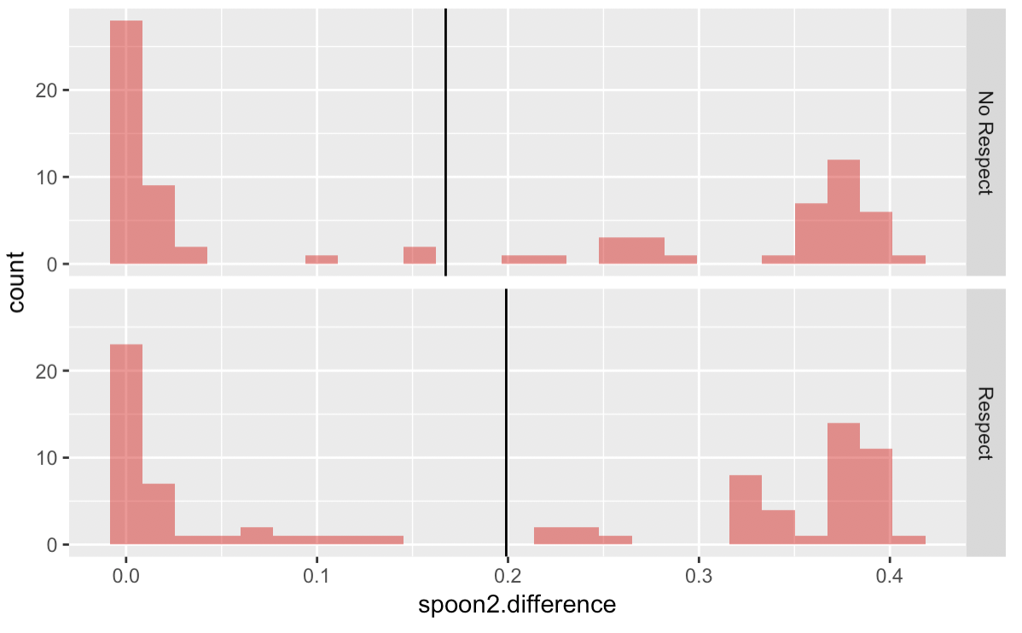
What are the possible causes of the mean difference in this shuffled distribution?

Slide 13
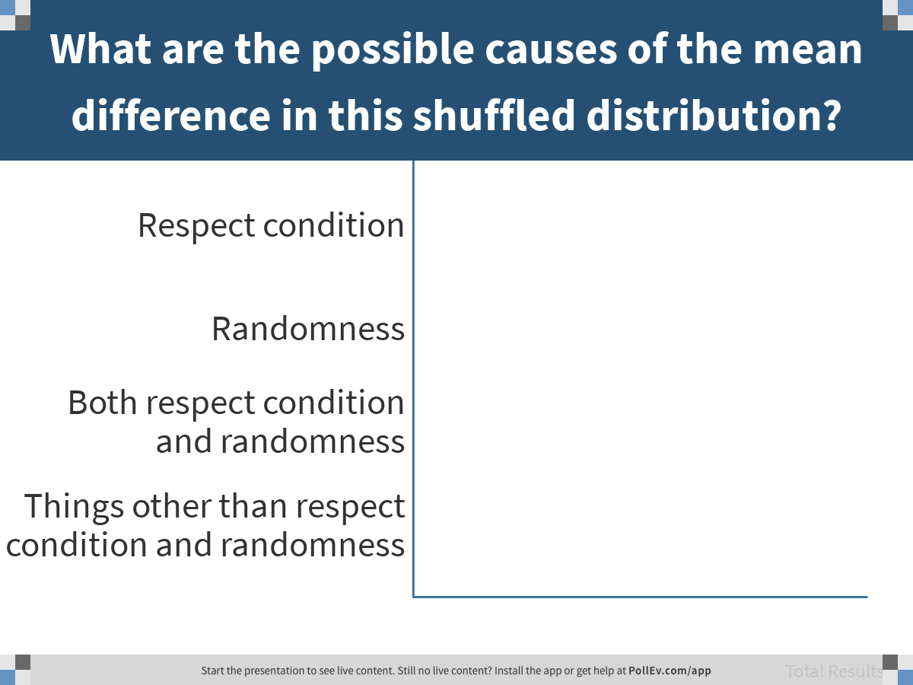
Notes:
What are the possible causes of the mean difference in this shuffled distribution?
https://www.polleverywhere.com/multiple_choice_polls/6VuIvaS1WJiM6BGxrf07G

Slide 14
Specifying the Two-Group Model

Slide 15
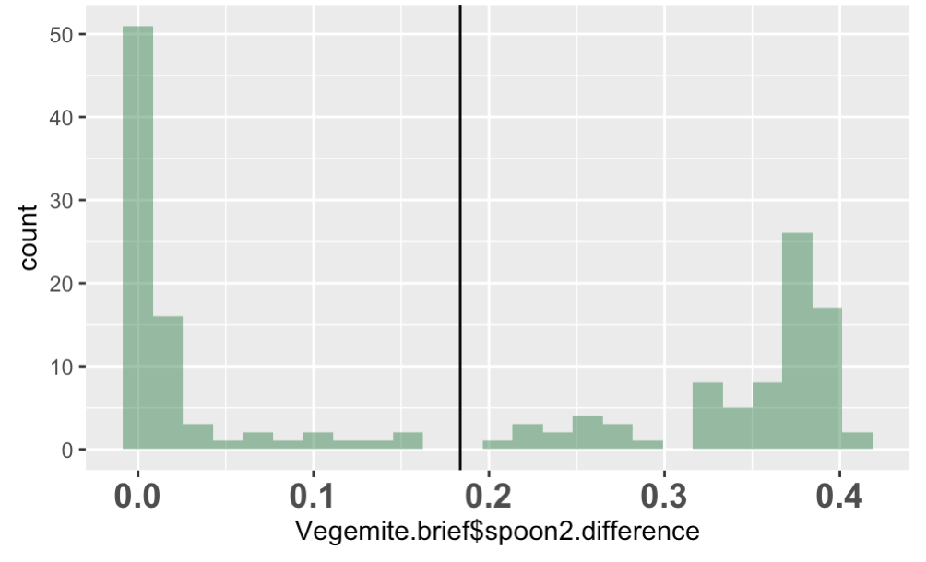
DATA = MODEL + ERROR
vegemite eaten = respect + error
vegemite eaten = mean + error
Write each model in GLM notation.

Slide 16
DATA = MODEL + ERROR
vegemite eaten = respect + error
vegemite eaten = mean + error

Slide 17
Fitting the Two-Group Model

Slide 18
Using Vegemite.brief data, fit and save two models of spoon2.difference:
empty.model
respect.model
Print out the two models

Slide 19
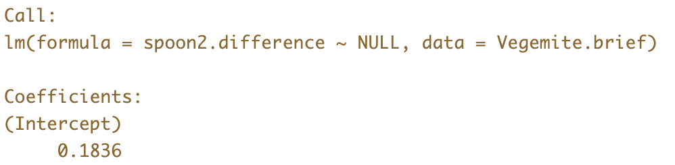
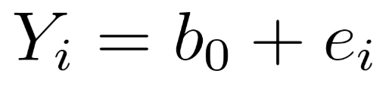
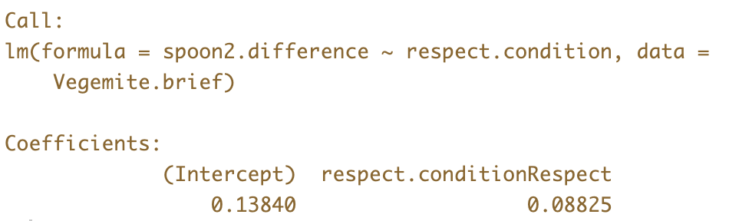
Fitting the Empty Model and the Two-Group Model
Empty
Model
Two-Group
Model

Slide 20
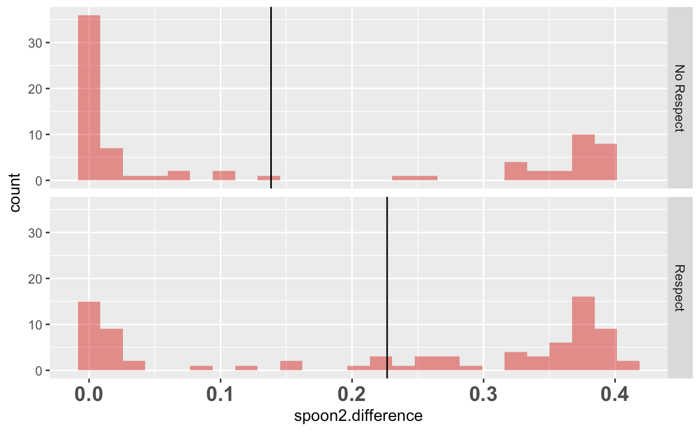
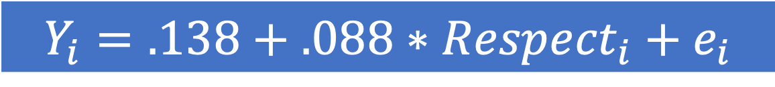
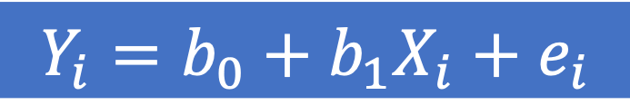
spoon2.difference by Respect
$$Y_{i}=b_{0}+b_{1}X_{i}+e_{i}$$
$$Y_{i}=.138+.088∗{Respect}_{i}+e_{i}$$

Slide 21


Using the Model to Make Predictions
$$Y_{i}=.138+.088∗{Respect}_{i}+e_{i}$$
$${\hat{Y}}_{i}=.138+.088∗{Respect}_{i}$$

Slide 22
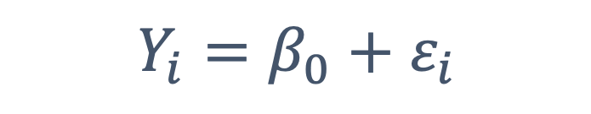
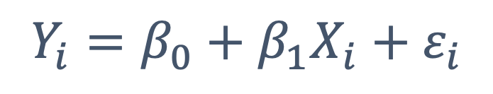
As the researcher, which parameter are we most interested in?
Empty
Model
$$Y_{i}=β_{0}+ε_{i}$$
Two-Group
Model
$$Y_{i}=β_{0}+β_{1}X_{i}+ε_{i}$$

Slide 23
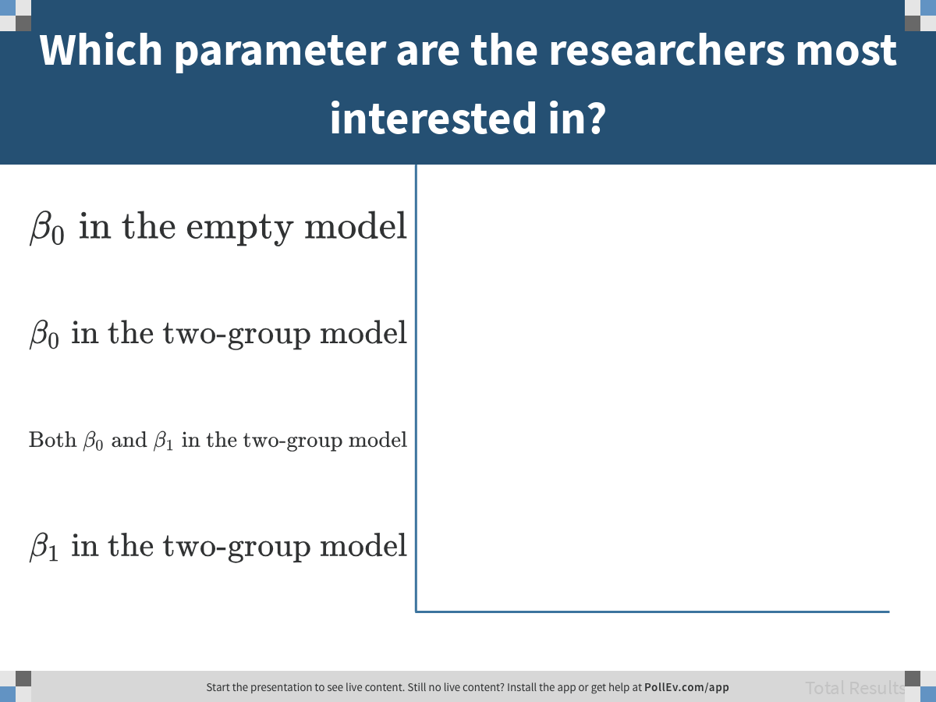
Notes:
Which parameter are the researchers most interested in?
https://www.polleverywhere.com/multiple_choice_polls/NMb6bJtZ9PPb5b3W3SnxR

Slide 24
Save the predicted and residual scores from the two models into the Vegemite.brief data frame.
Empty.predict & Empty.resid
Respect.predict & Respect.resid

Slide 25
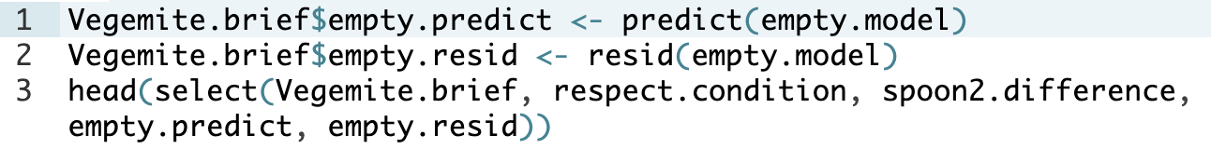
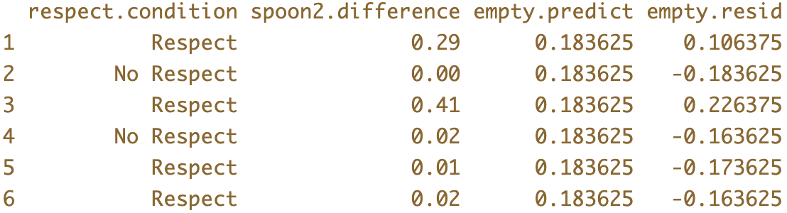

Predicted and Residuals from the Empty Model
$$\overline{Y}$$

Slide 26
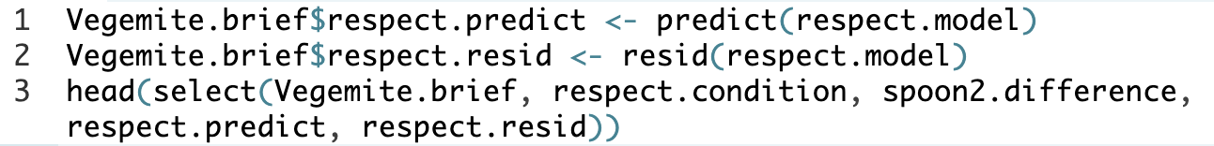
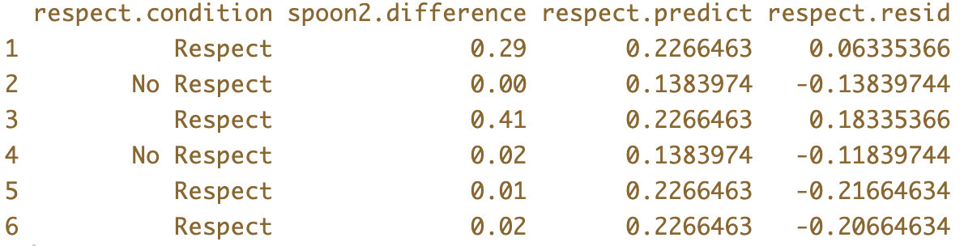

Predicted and Residuals from the Two-Group (Respect) Model
$${\overline{Y}}_{1}$$
$$\overline{Y}$$

Slide 27
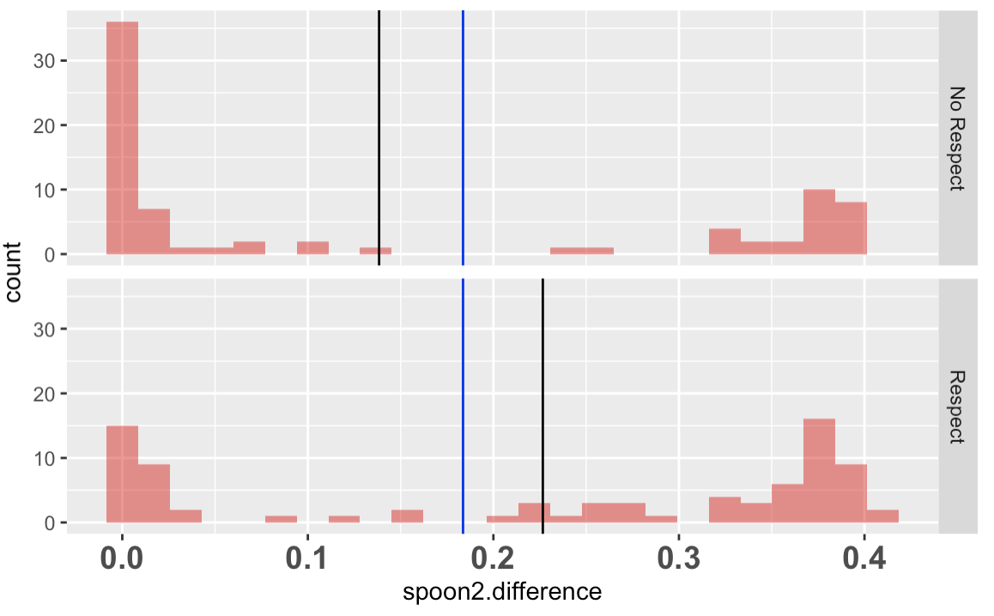
Error in the Two Models
Error at two levels: as residuals, and as totaled up in sum of squares.
A
B
B
A
SS Model
(explained)
SS Error (unexplained)
C
SS Total
C

